Slide 1
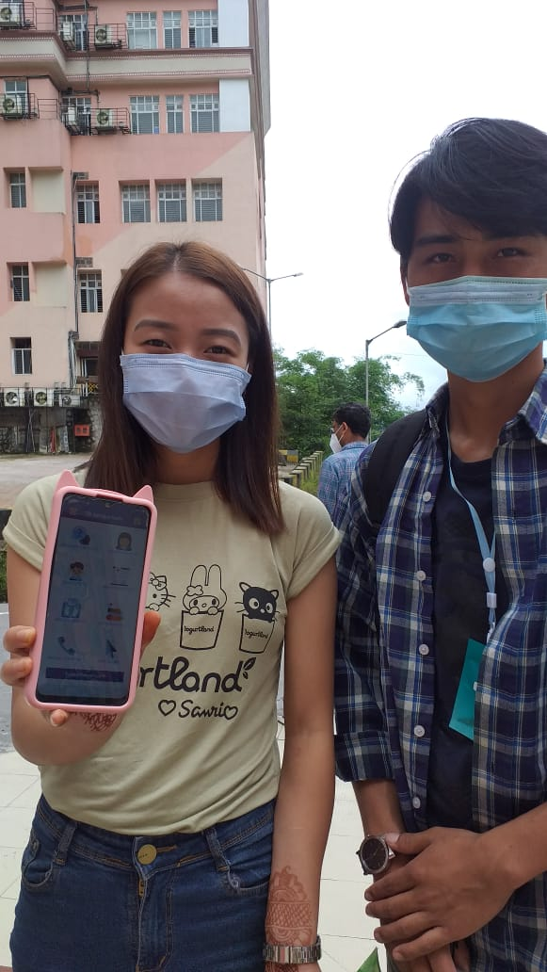
TB CHAMPIONS TEACHING PATIENTS TO DOWNLOAD AND USE TB AROGYA SATHI App.

Slide 2
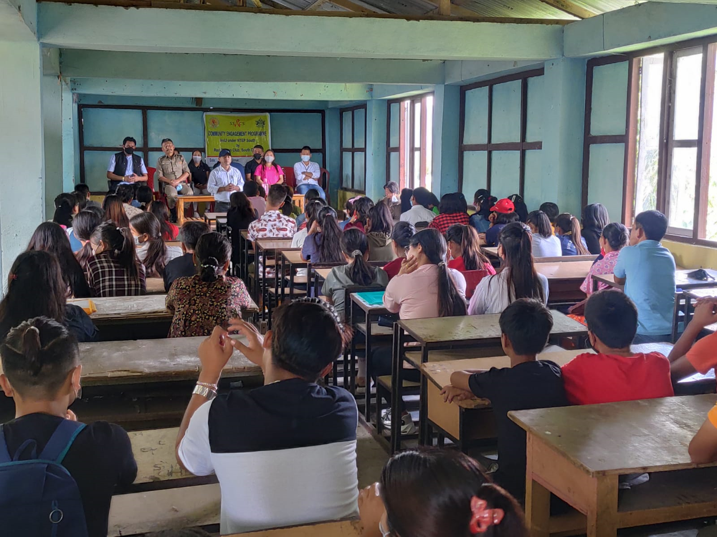
Community Engagement

Slide 3
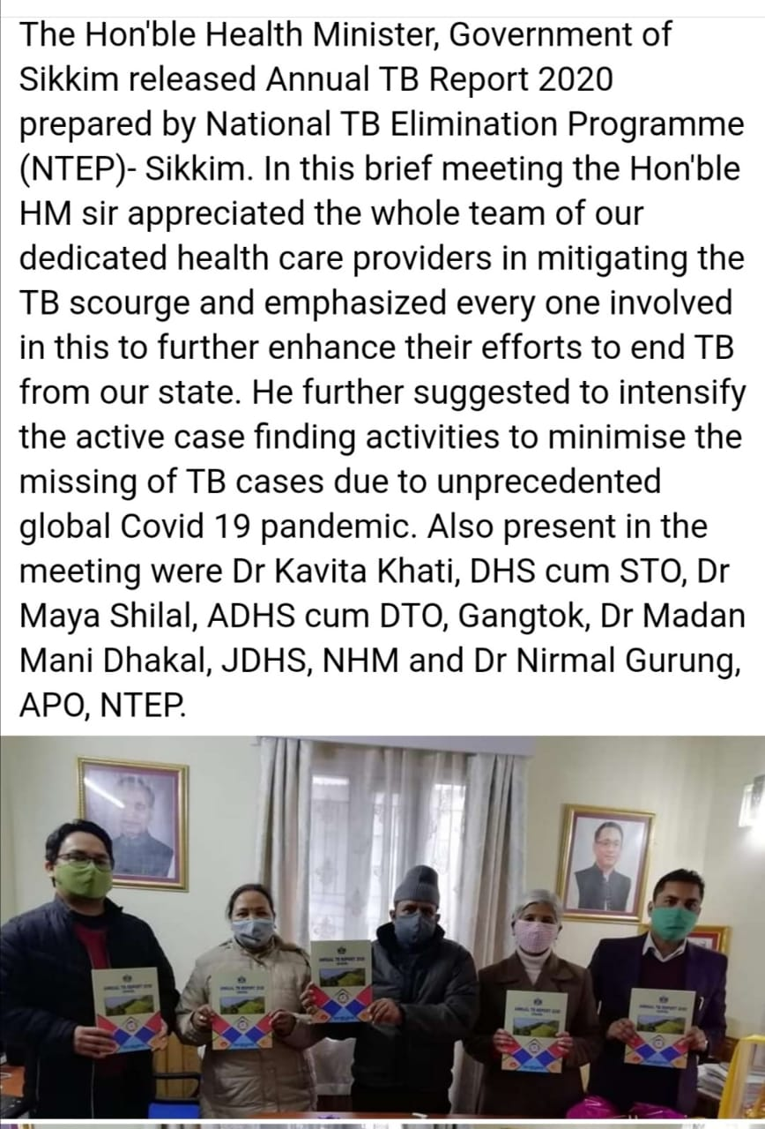
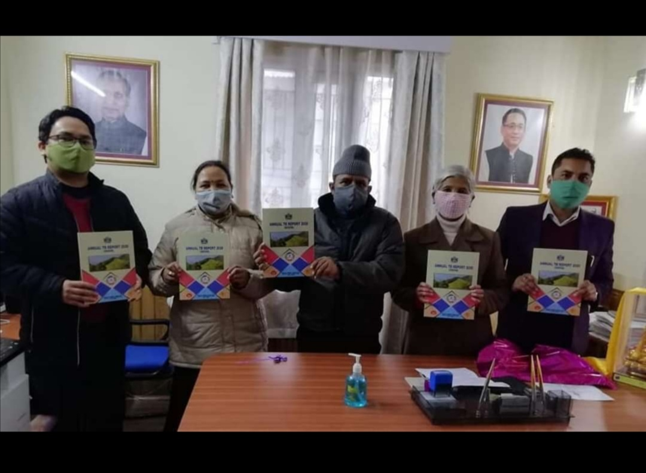
Released of Annual TB Report of Sikkim 2020 by Hon’ble Health Minister - Sikkim

Slide 4
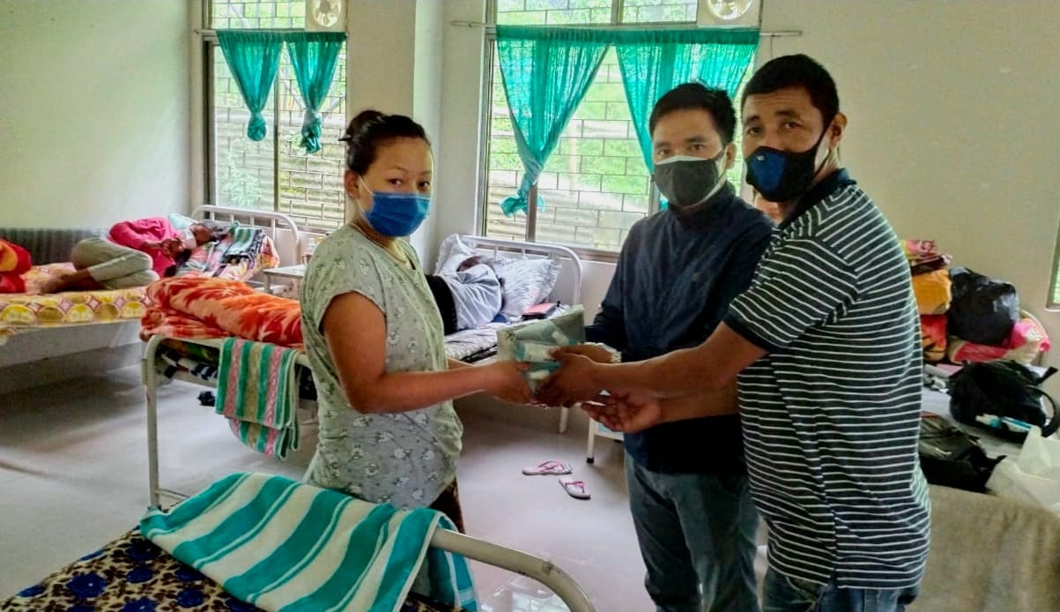
Nutritional Support to TB Patients

